Slide 1
COLLECTIVE
BARGAINING
AND YOU.

Slide 2
OBJECTIVES
Define unions and types of unions.
Brief review of the history of nursing unions.
Union in action real working scenarios.

Slide 3
ABOUT ME
Hello,
I am Ryan Rosenkranz RN, BSN
Nurse Organizer
BSN graduate from FL (can provide transcripts upon request)
Clinical Experience: Started IMC, ICU (Current per diem) 16 years
Certifications: CCRN, CMC, CSC
Started my union journey with WSNA as a staff nurse in 2009
Joined WSNA Staff in September of 2019

Slide 4
WHAT IS A UNION?
A union is a collection of employees who choose to exercise their right to be represented in matters pertaining to their wages and working conditions.

Slide 5
TYPES OF EMPLOYMENT
Right to work
At will
Putting it together
The term "right to work" is a law that makes forming and joining a union more difficult for employees.
On average states who are right to work such as Idaho, the gulf coast region of the US workers are paid less, have less benefits, more poverty and poorer working conditions.
The term "at will" means that an employer can fire you for any reason so long as it is not unlawful, and all 50 states other than Montana are "at will" states, some also being "right to work" states.
In both instances, right to work and at will, only a contract governs terms of employment such as discipline and discharge, wages, working conditions, benefits, retirement contributions. Without an employment contract such as a collective bargaining agreement an employee can be terminated at any time with no recourse.

Slide 6
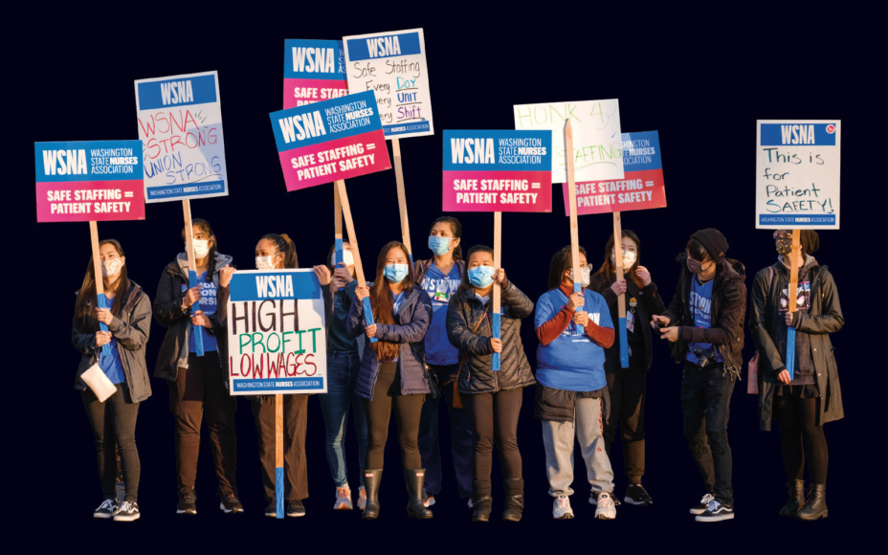
HISTORY OF NURSING UNIONS IN THE US
1794 - The first labor union was founded in- The Federal Society of Journeymen Cordwainers (shoemakers)
1913 - US Department of Labor was created.
1935 Congress passed the National Labor Relations Act (NLRA or the Wagner Act) which gave workers the rights to form unions and engage in collective bargaining.
1968 - The ANA reverses rule making on a no-strike policy for nurses as the civil rights movement and depressed nursing wages saw nurses in the San Francisco Bay area resigning en masse due to low wages.

Slide 7
Types of unions
Professional
Typically represent one class of employee such as WSNA.
Institutional or "Wall to Wall"
These unions represent anyone within a facility or "shop" that want to be represented such as CNAs, Dietary, Pharmacy etc. UFCW3000 and SEIU1199NW are examples of institutional unions.
Which one is better?
Simply put any unionized facility will offer more protections for wages and working conditions than a nonunionized due to the rights of a union member.

Slide 8
SO, WHAT'S THE DEAL WITH COLLECTIVE BARGAINING?

Slide 9
A RISING TIDE LIFTS ALL BOATS - JOHN F. KENNEDY 1963

Slide 10
THE POWER OF THE COLLECTIVE
Collective bargaining gives the power to the people engaging in bargaining.
Nursing wages are set on supply and demand instead of traditional industries where cost of living dictates wage increases.
When one unit secures high wages, unions use this to bring up wages across their bargaining units or shops.
For example: The raises at Pullman Regional Hospital helped secure a 13% increase for nurses at Kittitas Valley Hospital.
On average nonunionized workers make 15% less than unionized workers.

Slide 11
RIGHTS OF UNION EMPLOYEES
Weingarten Rights.
Grievance Rights.
Understanding your pay rates/differentials and contract
The right to steer the direction of the union's work.
The right to representation in matters of discipline.

Slide 12
WEINGARTEN RIGHTS
These rights were granted by a US supreme court decision in 1975 which offers the following rights to union employees:
1.) The right to representation - in a union environment you can request a union member, steward, or officer to be present during any conversation that may lead to termination or discipline.
2.) The right to know the basis for the meeting prior to meeting.
3.) The right to call a caucus (a time out) to confer privately with a union representative.
So why is this important?

Slide 13
UNIONS PROTECT THE PROCESS
A common misconception is that unions protect bad employees when what unions do is protect the process of fair investigation and discipline.
Let's imagine that you as a new graduate are trained by a preceptor that tells you the policy pertaining to dress code is never enforced and it is fine to have visible tattoos. One day you are called into your managers office with a concern relating to your professional appearance. Now what?

Slide 14
WITHOUT A UNION
You enter your managers office alone.
Sitting across the table is your manager and HR.
They show you a policy that says, "No visible tattoos" that you acknowledged when you were given a million other policies and things to sign when you were hired.
You are disciplined and told you must wear sleeves that cover your visible tattoos while your preceptor shakes their head and says, "They always do this, it will stop eventually."

Slide 15
WITH A UNION
You are prepared to enter the meeting by a representative of the union, and you walk in together. Your union representative takes notes throughout the conversation.
Sitting across the table is your manager and HR.
They show you a policy that says, "No visible tattoos" that you acknowledged when you were given a million other policies and things to sign when you were hired.
A caucus is called, and your representative asks you about other nurses on your unit with visible tattoos.
Upon your manager's return your union representative illustrates this policy is not enforceable due to the selective application for you only.

Slide 16
WITH A UNION
If your manager proceeds with discipline after the meeting, you have the right to a grievance which is a term to describe a formalized disagreement with your employer.
Each collective bargaining agreement lists the steps for each type of grievance.
The union argues on your behalf that you should not have been disciplined and asks for the discipline and all documents pertaining to your discipline to be removed.
In the event the grievance is denied by your employer the union may elect to take your case to arbitration which is a legally binding process for rulings on matters of contracts including discipline with cause.

Slide 17
ADVOCACY DOESN'T STOP AT THE BEDSIDE.

Slide 18
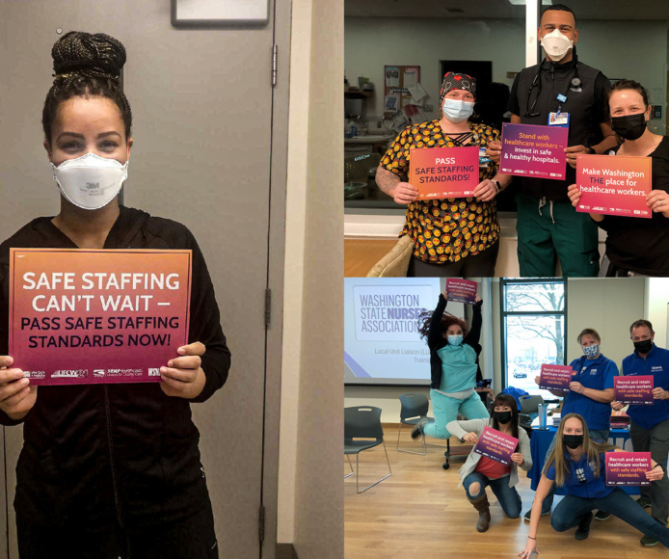
COLLECTIVE ACTION
Nursing collective action contains the following components:
To promote the practice of professional nursing.
To establish and maintain standards of care.
To allocate resources effectively and efficiently.
To create satisfaction and support in the practice environment.
Unions use collective action to move employers to provide safe work environments and increase visibility to ongoing problems within healthcare through legislative work and outreach.

Slide 19
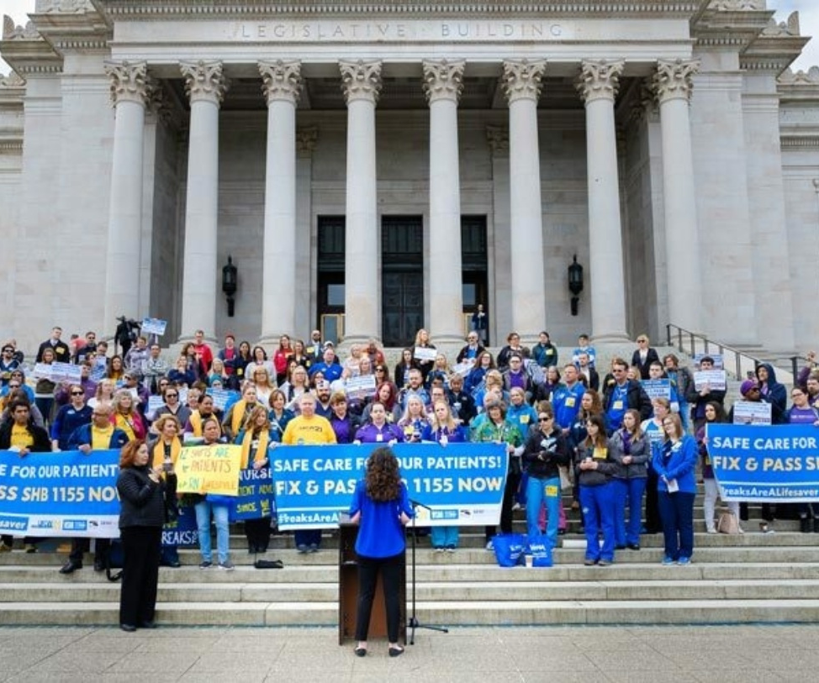
POLITICAL ACTION
Union dues cannot be used for political actions or for contributions to political candidates.
WSNA policy dictates we only participate in statewide elections and only issues that pertain to health and safety.
Recent legislative wins:
Staffing committee legislation - strengthens current language enacted in Washington around nurse staffing committees.
Increase in access to forensic education through grant funding for WSU.
Presumptive eligibility for nurses to claim L&I benefits for PTSD.

Slide 20
BE A UNION STRONG NURSE

Slide 21
WSNA.ORG
QUESTIONS?

