Slide 1
Regional Nurses Associations
in WA State

Slide 2
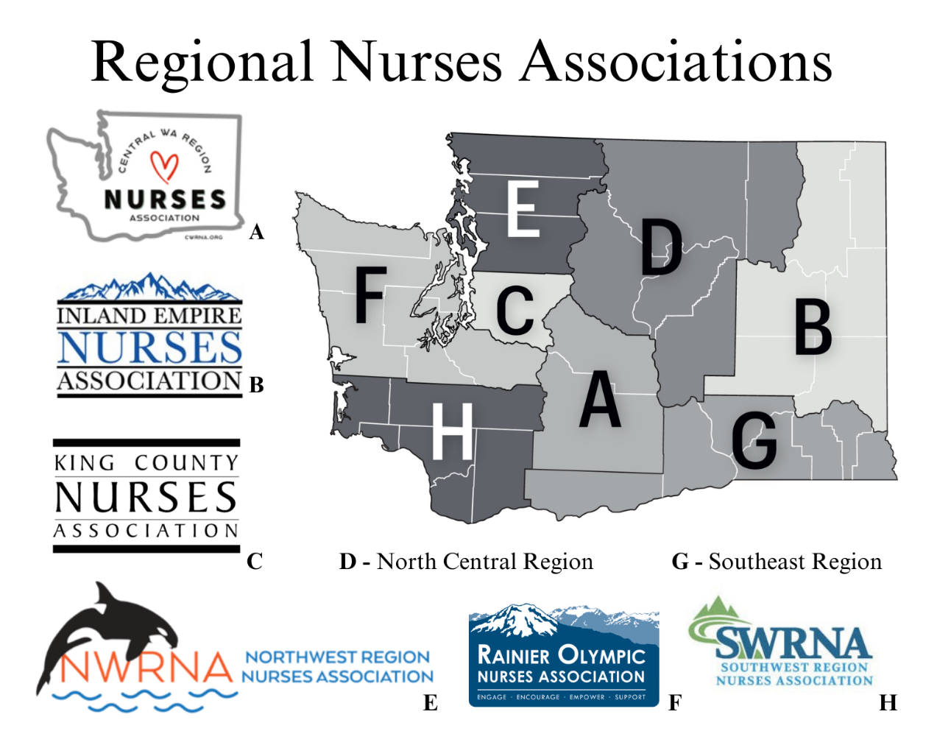

Slide 3
Membership
Regional Nurses
Association

Slide 4
Regional Nurses Associations
Local professional associations across the state
that support nurses in their communities.
Provide continuing education for nurses
Raise funds for and award scholarships to nursing students
Hold events to build community
Celebrate nurses and the profession of nursing
Nurses Week Celebrations
Promote nursing as a profession
Partner with WSNA for Nurses Speak Events and legislative advocacy.

Slide 5
Why be Active with your
Professional Association?
Gain leadership skills
Stay up to date about clinical practice
Support fellow nurses and future nurses
Connect with other nurses
Give back to your nursing community

Slide 6
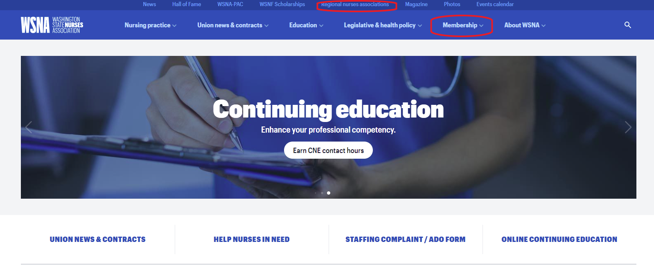
Membership
Visit www.wsna.org

Slide 7
Get Connected
Central WA Region Nurses Association
cwrna.org
Inland Empire Nurses Association
ienanurses.org
King County Nurses Association
kcnurses.org
Northwest Region Nurses Association
nwrna.org
Rainier Olympic Nurses Association
rainierolympicnurses.org
Southwest Region Nurses Association
waswrna.org
Central Washington Region Nurses Association
Inland Empire Nurses Association
King County Nurses Association
Northwest Region Nurses Association
Rainier Olympic Nurses Association
Southwest Region Nurses Association

